Slide 1
SPECIAL DISCRETE PROBABILITY DISTRIBUTION
THE BINOMIAL DISTRIBUTION

Slide 2
Characteristics of a binomial distribution
A finite number, n, trials are carried out,
The trials are independent,
The outcome of each trial is deemed either a success or a failure,
The probability , p, of a successful outcome is the same for each trial

Slide 3
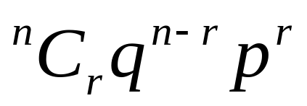
Formula
X ~ Bin(n,p) where n is the number of independent trials and p is the probability of a successful outcome in one trial
P(X=r) =

Slide 4
Example 1
An ordinary die is thrown seven times. Find the probability of obtaining exactly three sixes.

Slide 5
Example 2
The probability that a person supports Party A is 0.6. Find the probability that in a randomly selected sample of 8 voters there are (a) exactly 3 who support Party A, (b) more than 5 who support Party A.

Slide 6
Example 3
At Sellitall Supermarket, 60% of customers pay by credit card. Find the probability that in a randomly selected sample of ten customers,
A) exactly two pay by credit card,
B) more than seven pay by credit card.

Slide 7
Example 4
A box contains a large number of red and yellow tulip bulbs in the ratio 1:3. Bulbs are picked at random from the box. How many bulbs must be picked so that the probability that there is at least one red tulip bulb among them is greater than 0.95?

Slide 8
Example 5
A box contains a large number of pens. The probability that a pen is faulty is 0.1. How many pens would you need to select to be more than 95% certain of picking at least one faulty one?

